Slide 1

2023-2024 State Assessment Report
Part III: NJSLA and DLM

Slide 2

2023-2024 State Assessment Report
Included in this Report:
New Jersey Student Learning Assessments
      English Language Arts
      Mathematics
      Science
Dynamic Learning Maps

Slide 3
Setting our Data Lens….
The data sets presented here reflect one measure used in each subject to help us understand each learner and to plan for and promote each learner’s growth.
NJSLA and DLM only consider Mathematics, English Language Arts and Science in some grade levels and not all that we value in our district.

Slide 4
2022-2023 State Assessment Report
Thanks to our…
Curriculum and Special Education Supervisors
Director of Special Services
Principals and Assistant Principals
Testing Coordinators
      Ms. Lisa Howard - Grades 3-8
      Dr. Timothy Donahue - Grades 9-12
Board Curriculum Committee
Teachers, Specialists, CST Members and Aides
Students and their Families/Caregivers

Slide 5

Dynamic Learning Maps
Alternative Assessment
Spring, 2024

Slide 6
The DLM is administered to students in the state with the most significant cognitive disabilities whose Individualized Education Program (IEP) designate the state’s alternate assessment as the most appropriate academic assessment.
Students in grades 3-8, and 11 take the DLM in English Language Arts and Math.
Students in grades 5, 8, and 11 take the DLM Science.

Slide 7
SPF DLM Results 2024
 | Total | Emerging | Approaching | Target | Advanced
English Language Arts | 17 | 6 | 4 | 5 | 2
Mathematics | 18 | 6 | 5 | 4 | 3
Science | 5 | 3 | 1 | 1 | 0
How do we use DLM data?
Curricular decisions
Instructional feedback
As an additional data point to monitor student progress and growth.

Slide 8

English Language Proficiency Testing for
Multilingual Learners
Spring, 2024

Slide 9
Administered to Kindergarten through 12th-grade students who have been identified as Multilingual Learners
Given annually to monitor students' progress in learning academic English
Meets U.S. federal requirements of the Every Student Succeeds Act (ESSA) for monitoring and reporting Multilingual Learners’ progress toward English language proficiency
Assesses the four language domains of Listening, Speaking, Reading and Writing

Slide 10
SPF ACCESS for ELLs Results 2024
Administered to 97 English Language Learners.
Scored on English Language Proficiency Levels from 1 to 6.
18 students received a score of 4.5 or higher, qualifying them to exit the ESL program.

Slide 11

New Jersey Student Learning Assessment

Slide 12
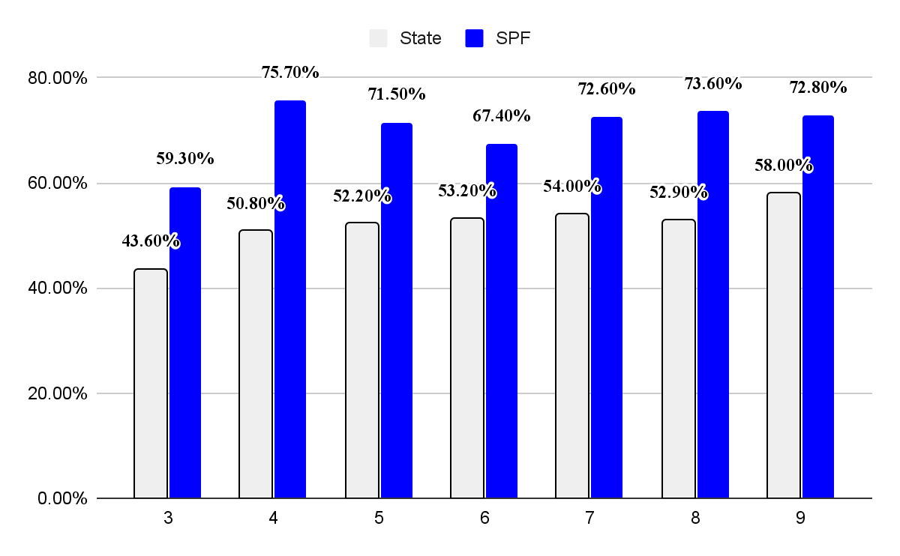
2024 ELA State/SPF Comparison

Slide 13
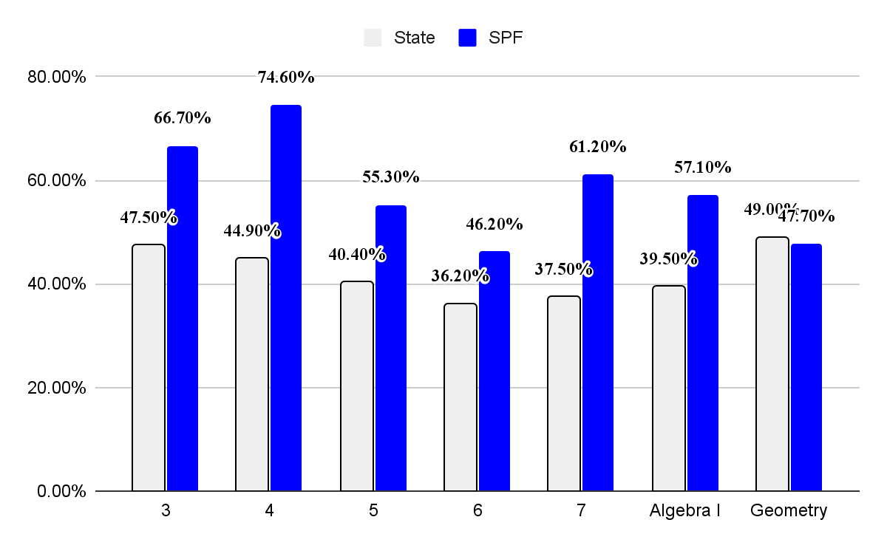
2024 Math State/SPF Comparison

Slide 14
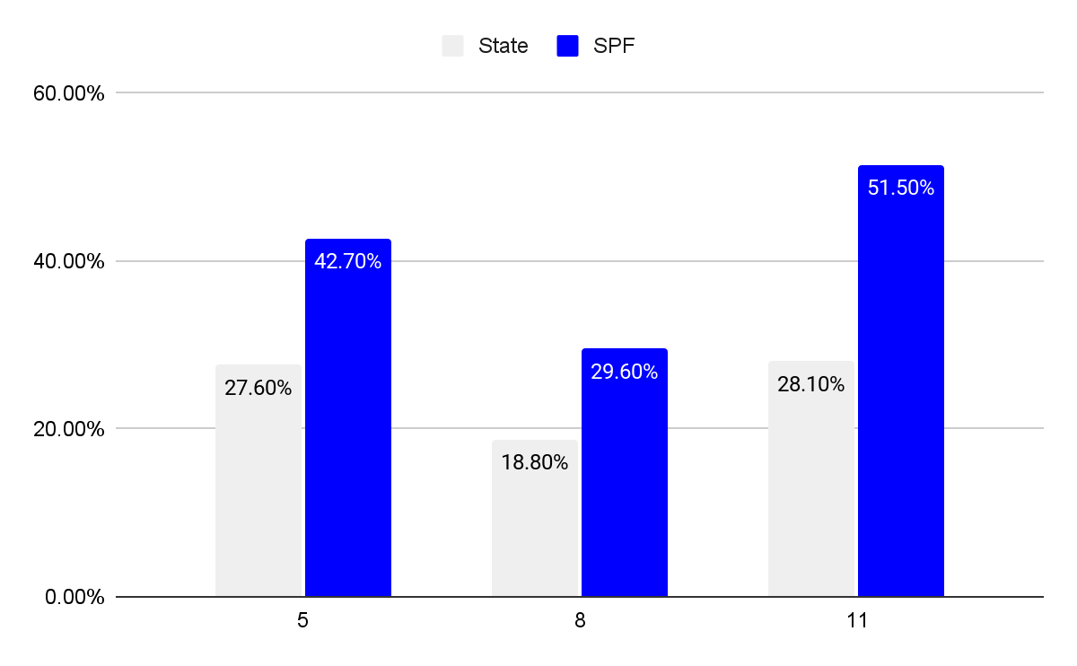
2024 Science State/SPF Comparison

Slide 15
Setting our Data Lens….
NJSLA ELA and Math Performance Levels
EXCEEDING GRADE LEVEL EXPECTATIONS
MEETING GRADE LEVEL EXPECTATIONS
APPROACHING GRADE LEVEL EXPECTATIONS
PARTIALLY MEETING GRADE LEVEL EXPECTATIONS
NOT YET MEETING GRADE LEVEL EXPECTATIONS

Slide 16
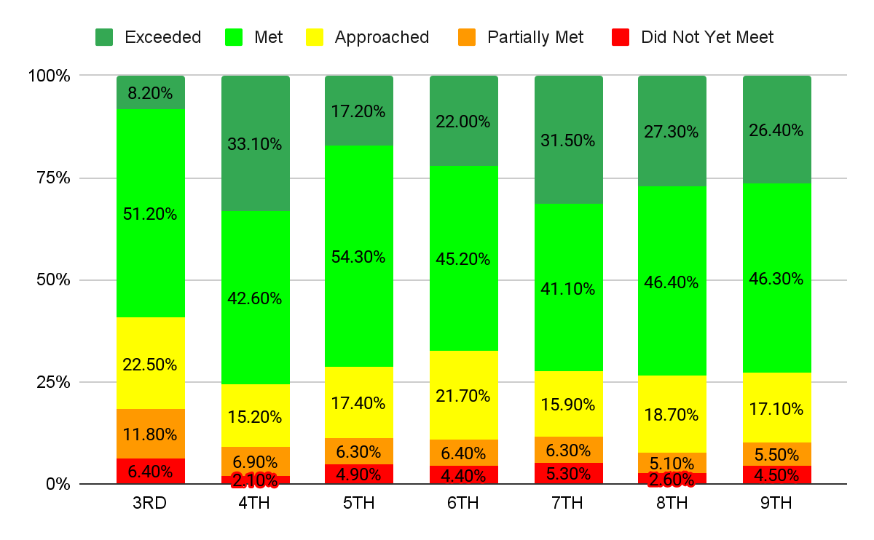
2024 SPF ELA 3-9 at a Glance

Slide 17
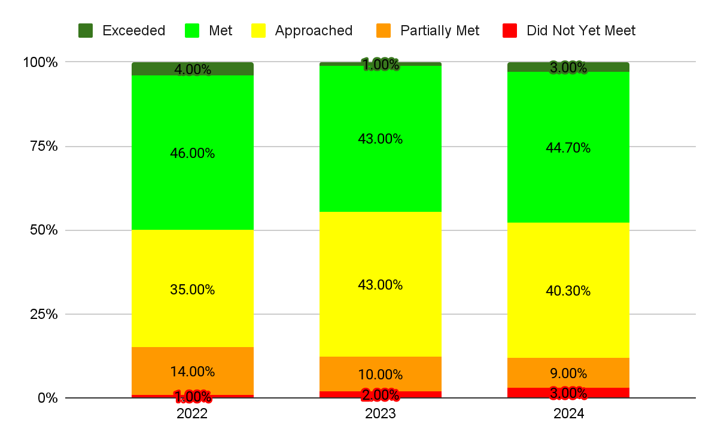
Setting our Data Lens… 3 Year View

Slide 18
<SUBJECT AND GRADE >
<SUBJECT AND GRADE >
Setting our Data Lens….

Slide 19
<SUBJECT AND GRADE >
<SUBJECT AND GRADE >
Setting our Data Lens….
SPF
NJ

Slide 20
Setting our Data Lens….
GRADE LEVEL ACHIEVEMENT OVER 3 YEARS
(DIFFERENT STUDENTS EACH YEAR)
DATA IS PRESENTED BY PERCENTAGE OF STUDENTS SCORING AT EACH LEVEL

Slide 21
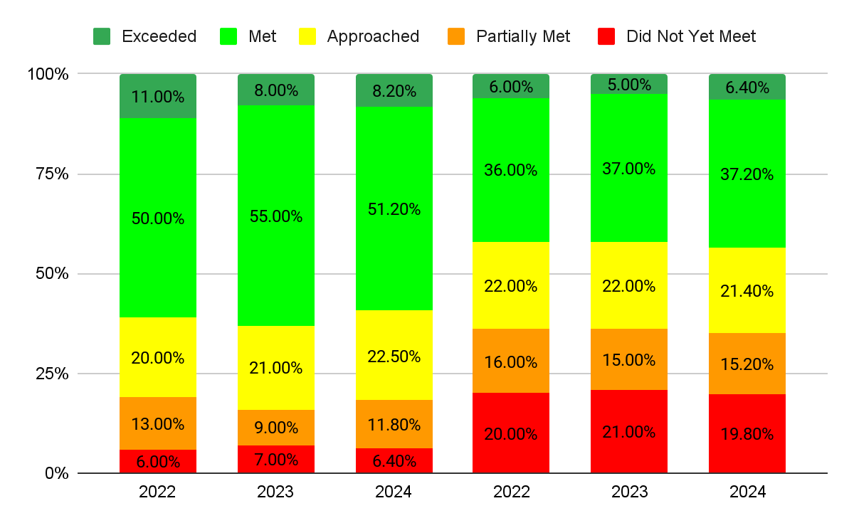
ELA 3 (2022 to 2024)
SPF
NJ

Slide 22
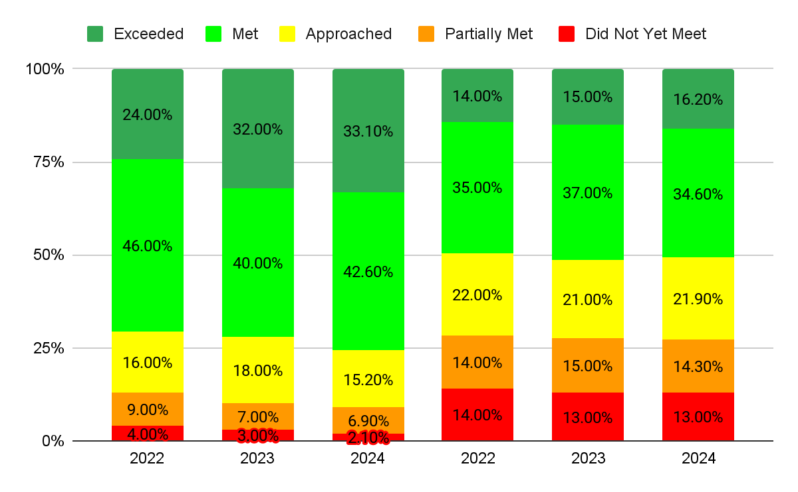
ELA 4 (2022 to 2024)
SPF
NJ

Slide 23
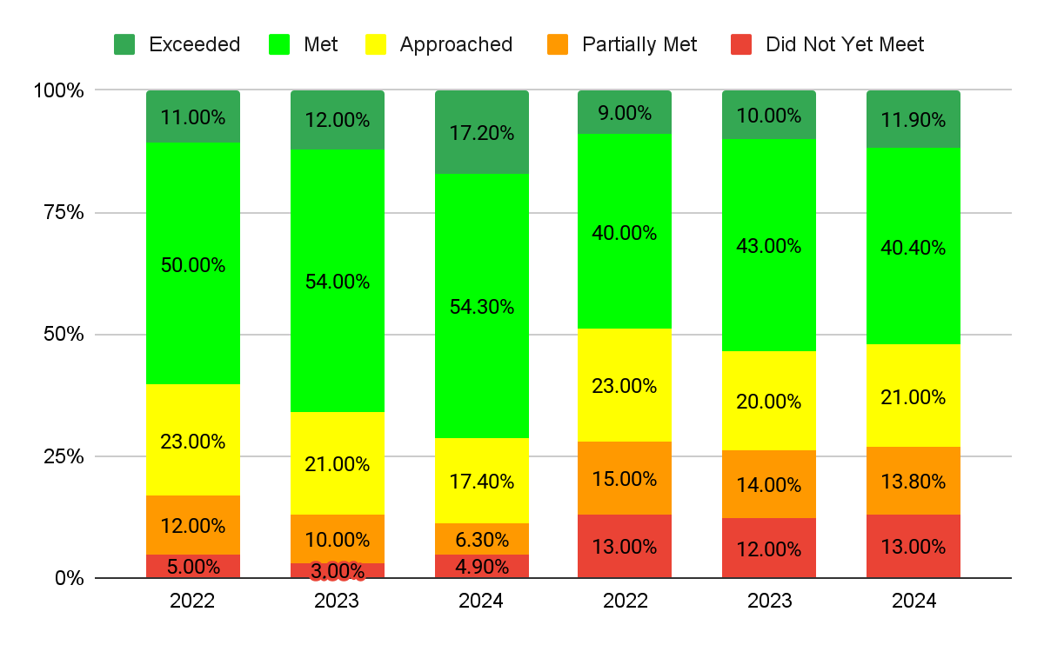
ELA 5 (2022 to 2024)
SPF
NJ

Slide 24
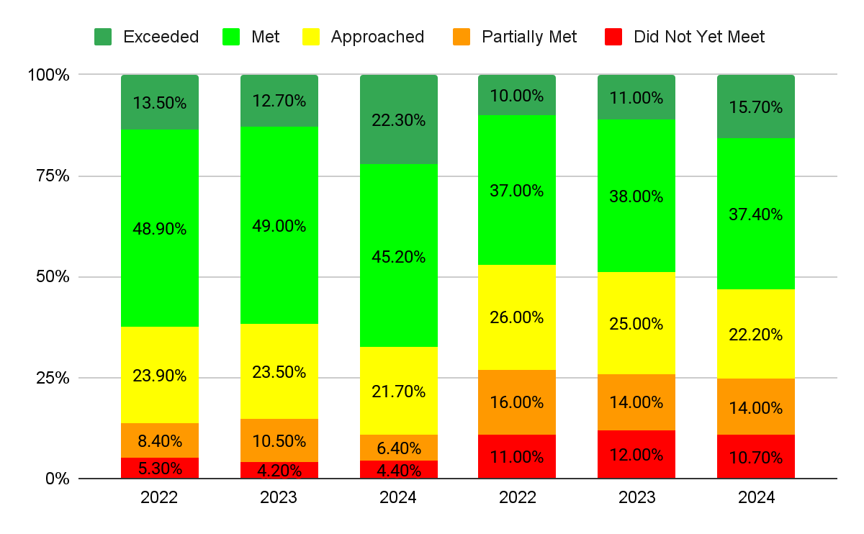
ELA 6 (2022 to 2024)
SPF
NJ

Slide 25
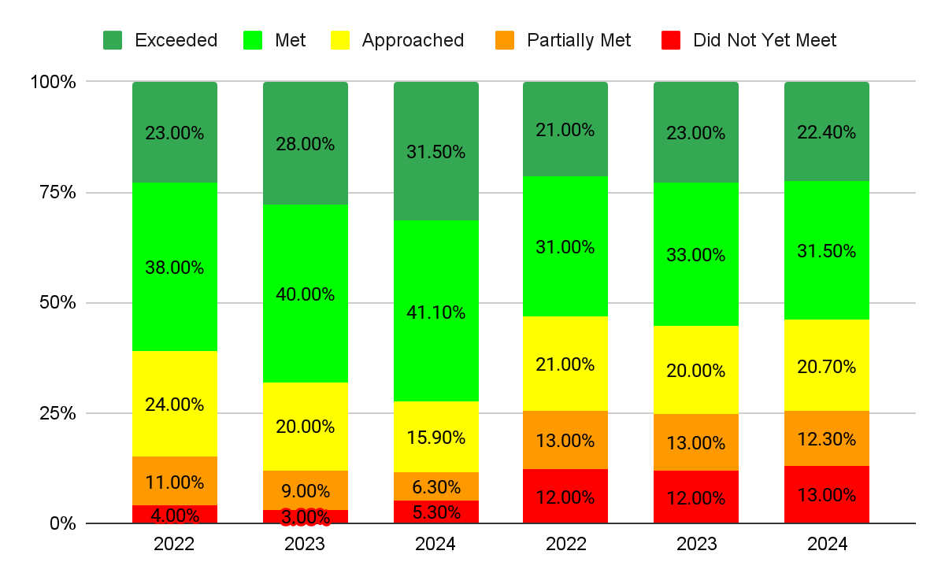
ELA 7 (2022 to 2024)
SPF
NJ

Slide 26
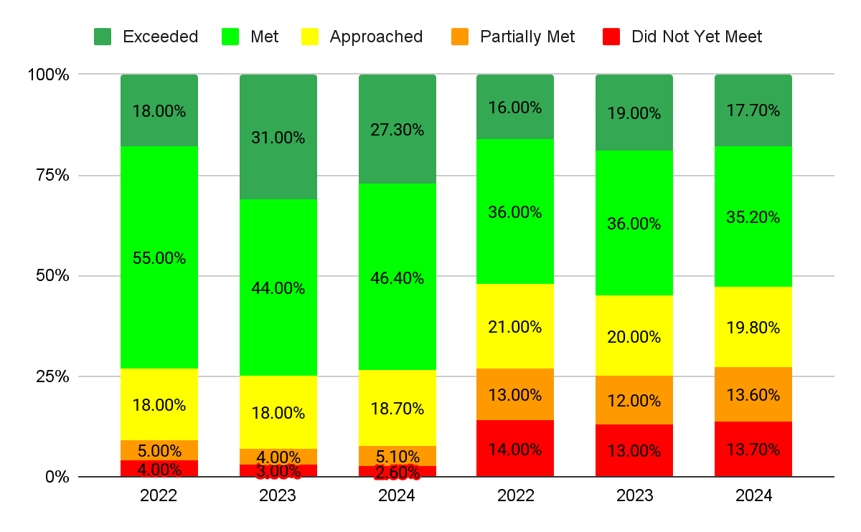
ELA 8 (2022 to 2024)
SPF
NJ

Slide 27
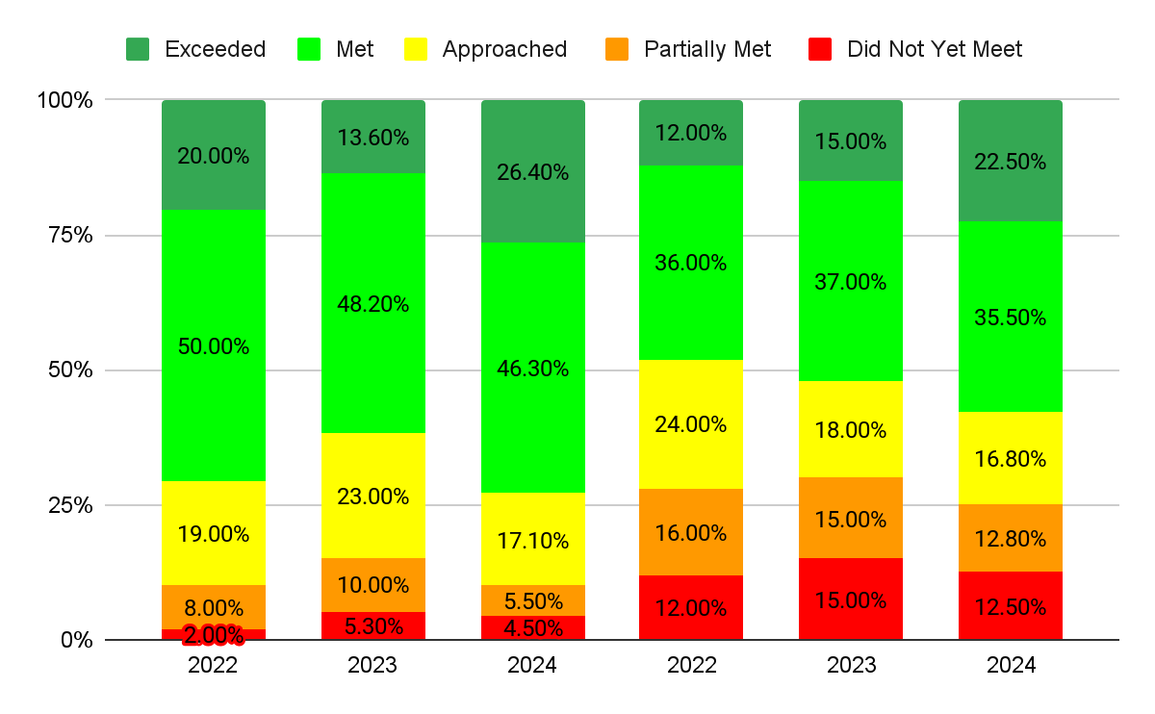
ELA 9 (2022 to 2024)
SPF
NJ

Slide 28
Setting our Data Lens….
COHORT GROWTH
DIFFERENT GRADE LEVELS - SAME STUDENTS
DATA IS PRESENTED BY PERCENTAGE OF STUDENTS SCORING AT EACH LEVEL

Slide 29
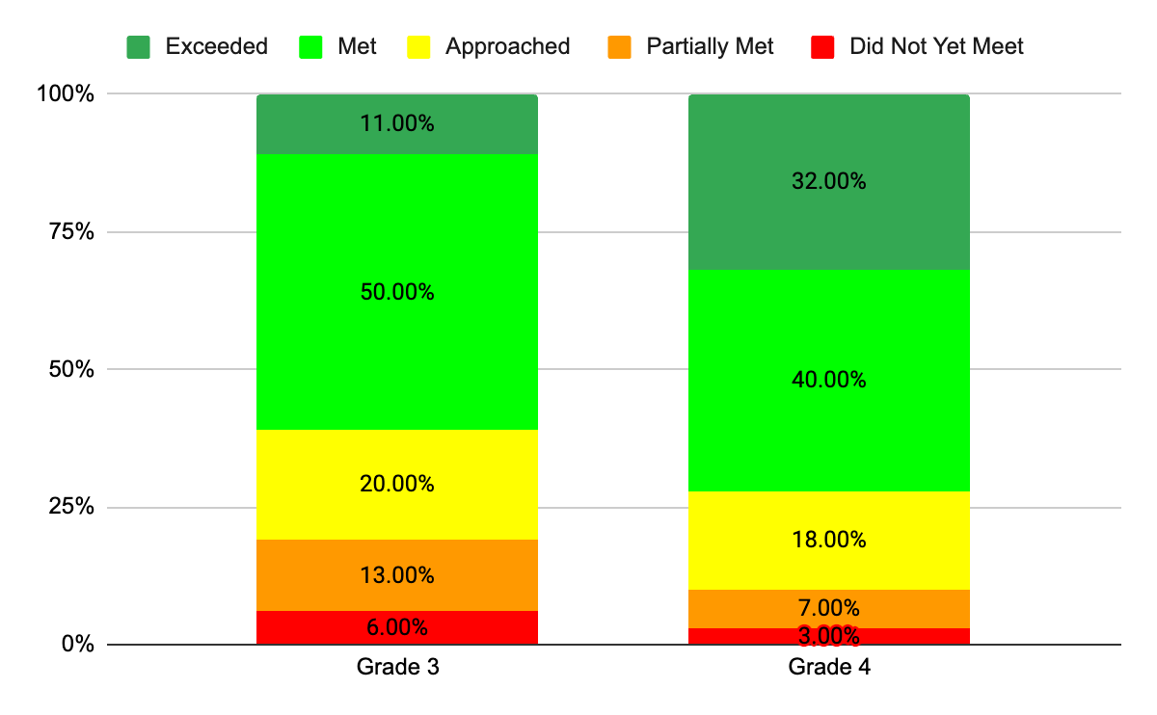
Current Grade 5 (ELA Cohort Growth - Grade 3 to Grade 4)

Slide 30
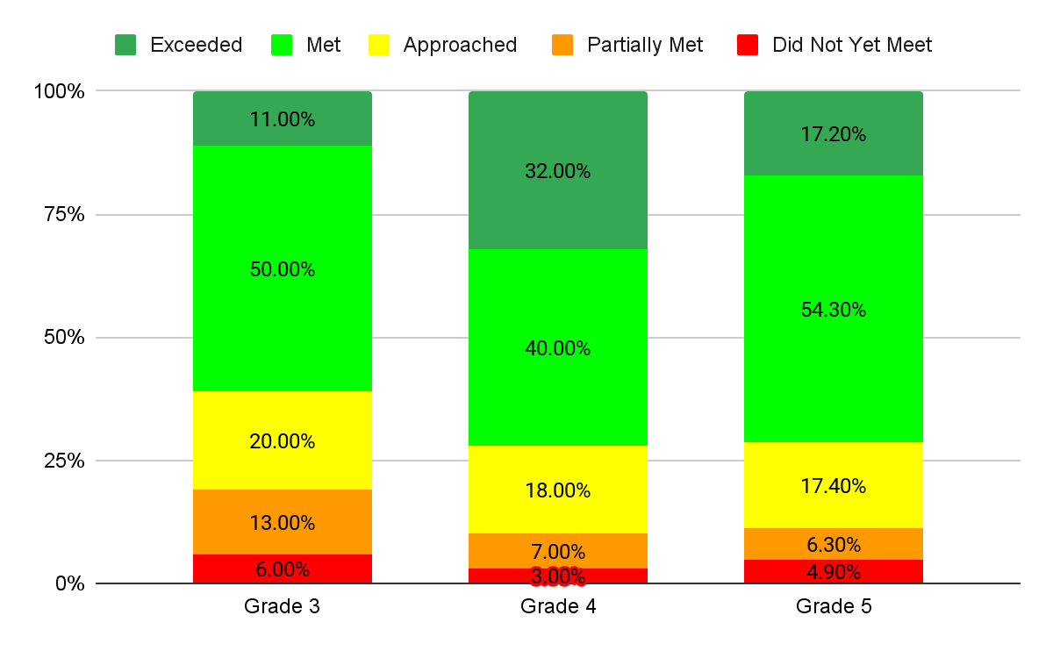
Current Grade 6 (ELA Cohort Growth - Grade 3 to Grade 5)

Slide 31
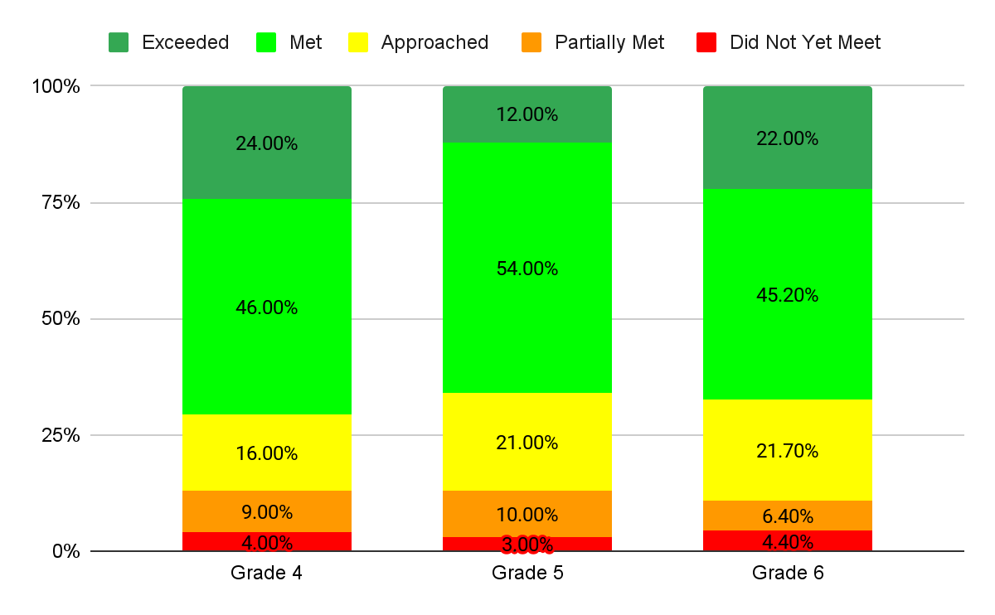
Current Grade 7 (ELA Cohort Growth - Grade 4 to Grade 6)

Slide 32
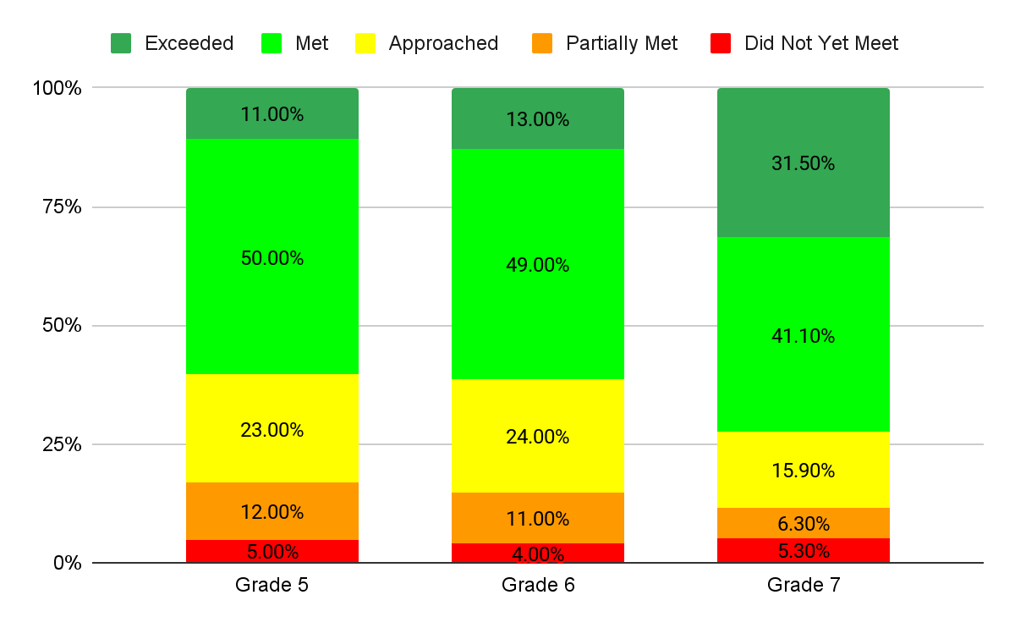
Current Grade 8 (ELA Cohort Growth - Grade 5 to Grade 7)

Slide 33
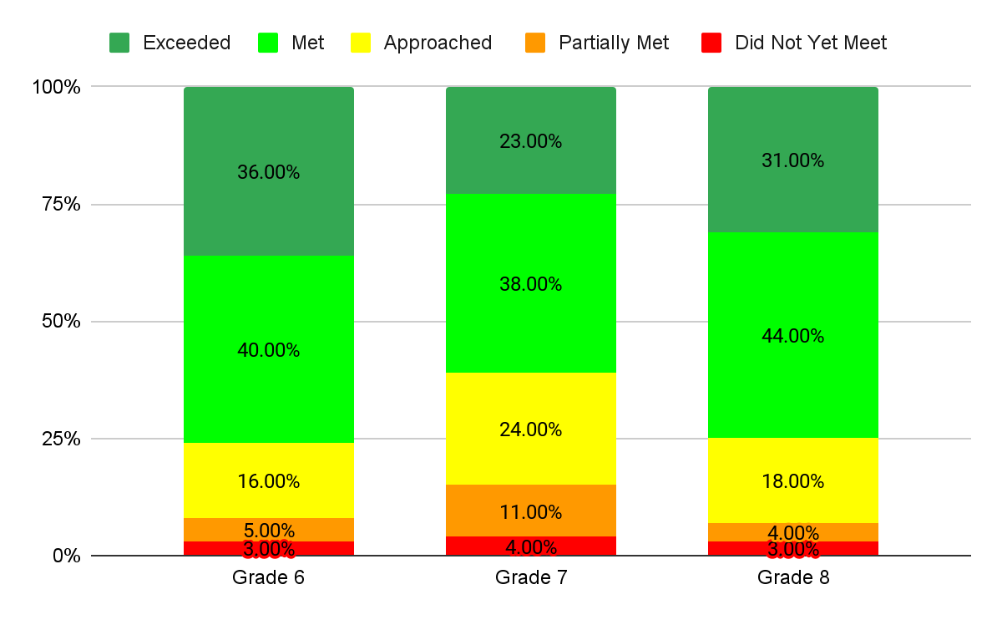
Current Grade 9 (ELA Cohort Growth - Grade 6 to Grade 8)

Slide 34
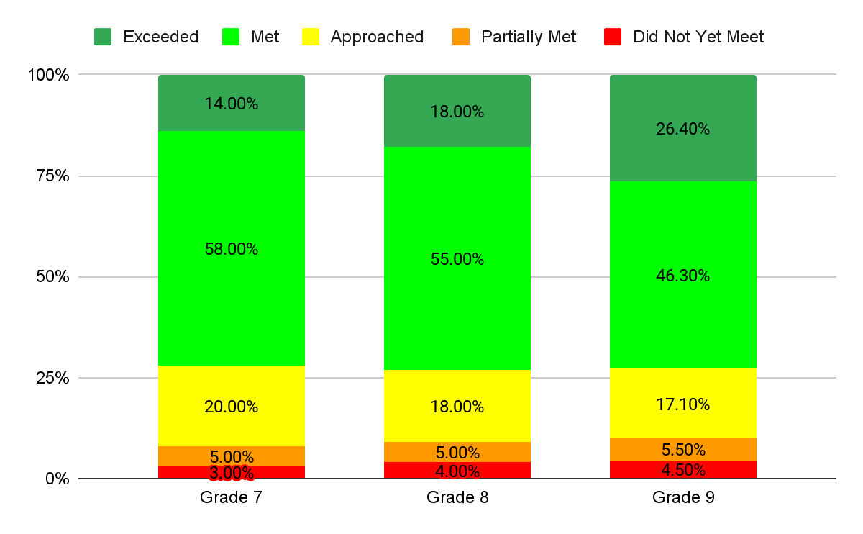
Current Grade 10 (ELA Cohort Growth - Grade 7 to Grade 9)

Slide 35
Setting our Data Lens….
ACHIEVEMENT BY DEMOGRAPHIC GROUPS
ELA
DATA IS PRESENTED BY
PERCENTAGE OF STUDENTS MEETING/EXCEEDING EXPECTATIONS

Slide 36
Percentage of Students Meeting/Exceeding Expectations - ELA
Gender | Total Tested | Percentage Meeting/Exceeding Expectations | +/- Change from 2023
Female | 1,488 | 75.96% | +1.54
Male | 1,473 | 64.81% | +4.26

Slide 37
Percentage of Students Meeting/Exceeding Expectations - ELA
Ethnicity/Race | Total Tested | Percentage Meeting/Exceeding Expectations | +/- Change from 2022
Hispanic or Latino | 440 | 55.24% | -0.15
Asian | 342 | 82.36% | +2.6
Black or African-American | 213 | 54.16% | +3.55
White | 1,785 | 67.31% | +0.97
Two or more races | 165 | 77.57% | +1.47

Slide 38
Percentage of Students Meeting/Exceeding Expectations - ELA
Program | Total Tested | Percentage Meeting/Exceeding Expectations | +/- Change from 2023
Students with Disabilities | 533 | 26.8% | -0.67
Economically Disadvantaged | 123 | 41.53% | +0.93
504 | 217 | 65.07% | +21.97
English Learners | 47 | 12.44% | +2.44

Slide 39
Summary Observations and Next Steps
English Language Arts

Slide 40
Summary Observations: ELA
Consistent above-state-average performance across all grades
Ongoing increase in ELA proficiency rates
Improved performance across diverse demographic groups
Growth in complex nonfiction comprehension skills
Need for continued focus on literary analysis in some grades

Slide 41
Next Steps: ELA
Leverage diverse assessments for targeted professional development and advanced literacy instruction
Enhance literary analysis instruction in elementary grades
Strengthen cross-curricular support for complex text comprehension
Refine 5th Grade Teaming and content-specific planning

Slide 42
Mathematics

Slide 43
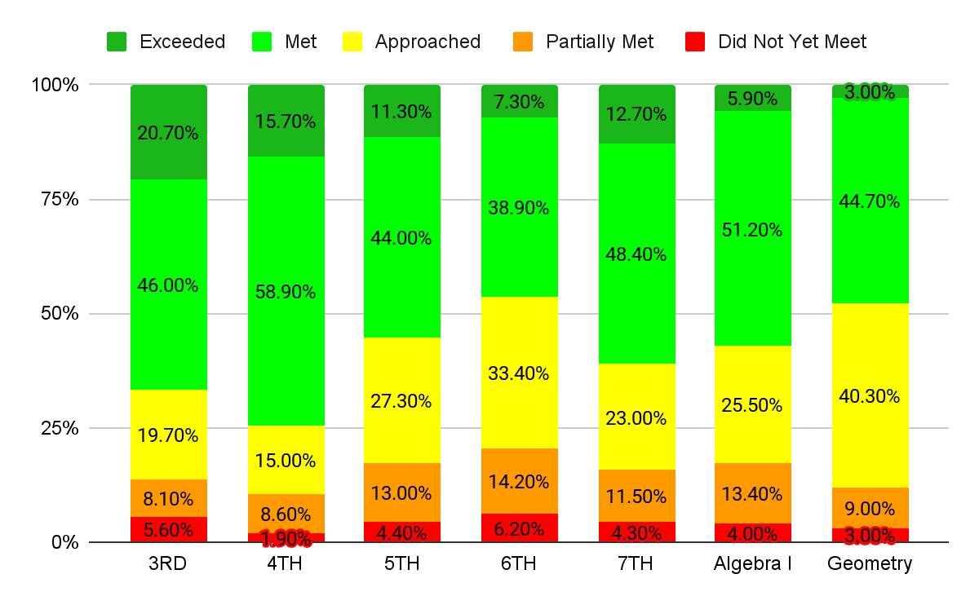
2024 SPF Math 3-Geometry at a Glance

Slide 44
Setting our Data Lens….
GRADE LEVEL ACHIEVEMENT OVER 3 YEARS
(DIFFERENT STUDENTS EACH YEAR)
DATA IS PRESENTED BY PERCENTAGE OF STUDENTS SCORING AT EACH LEVEL

Slide 45
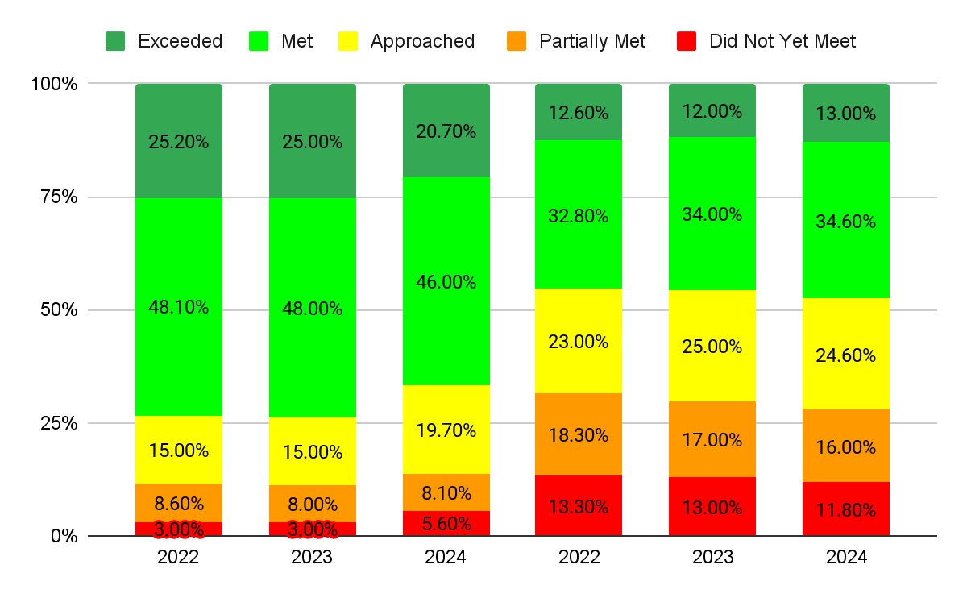
Math 3 (2022 to 2024)
SPF
NJ

Slide 46
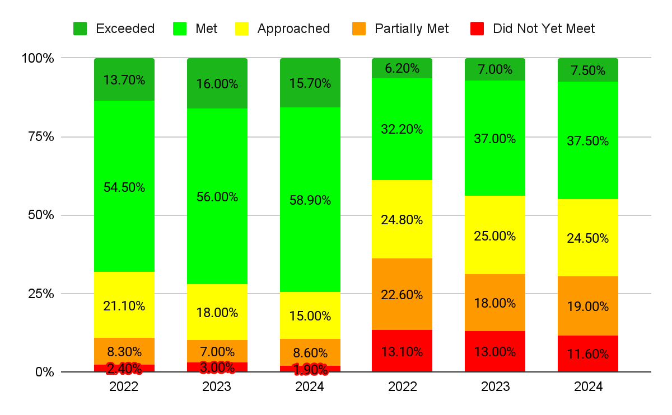
Math 4 (2022 to 2024)
SPF
NJ

Slide 47
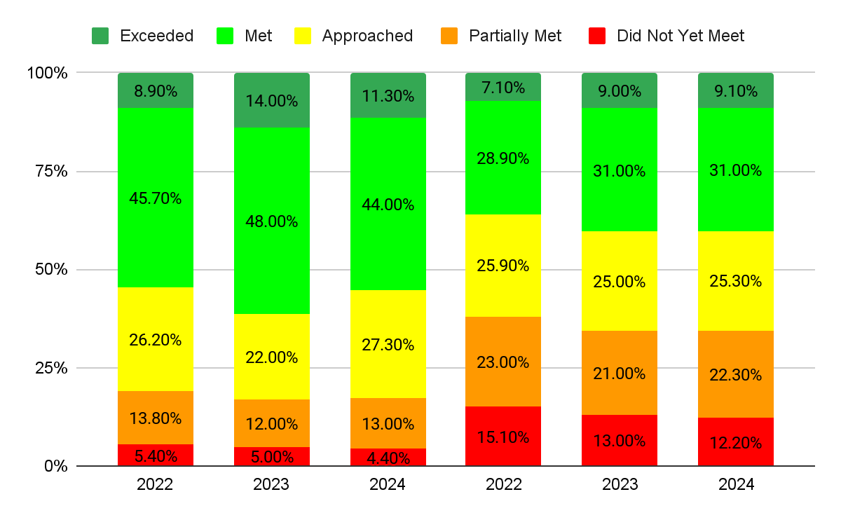
Math 5 (2022 to 2024)
SPF
NJ

Slide 48
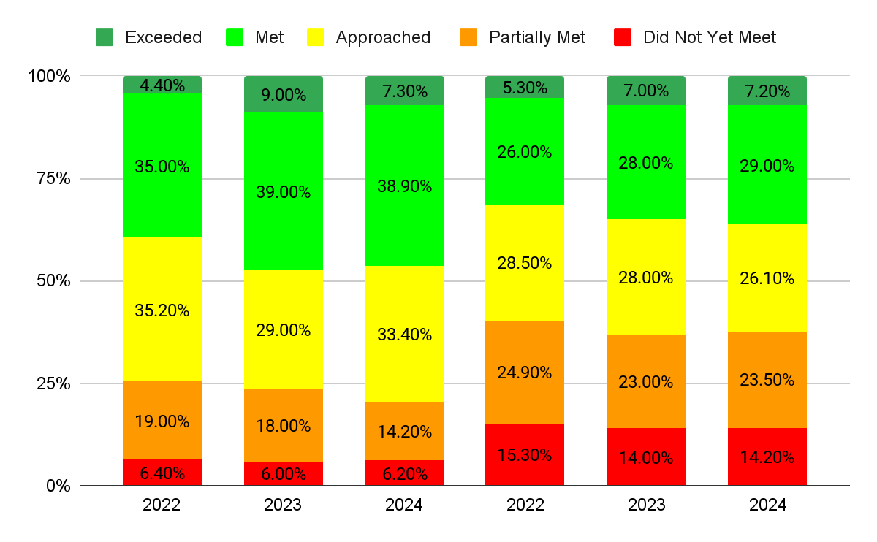
Math 6 (2022 to 2024)
SPF
NJ

Slide 49
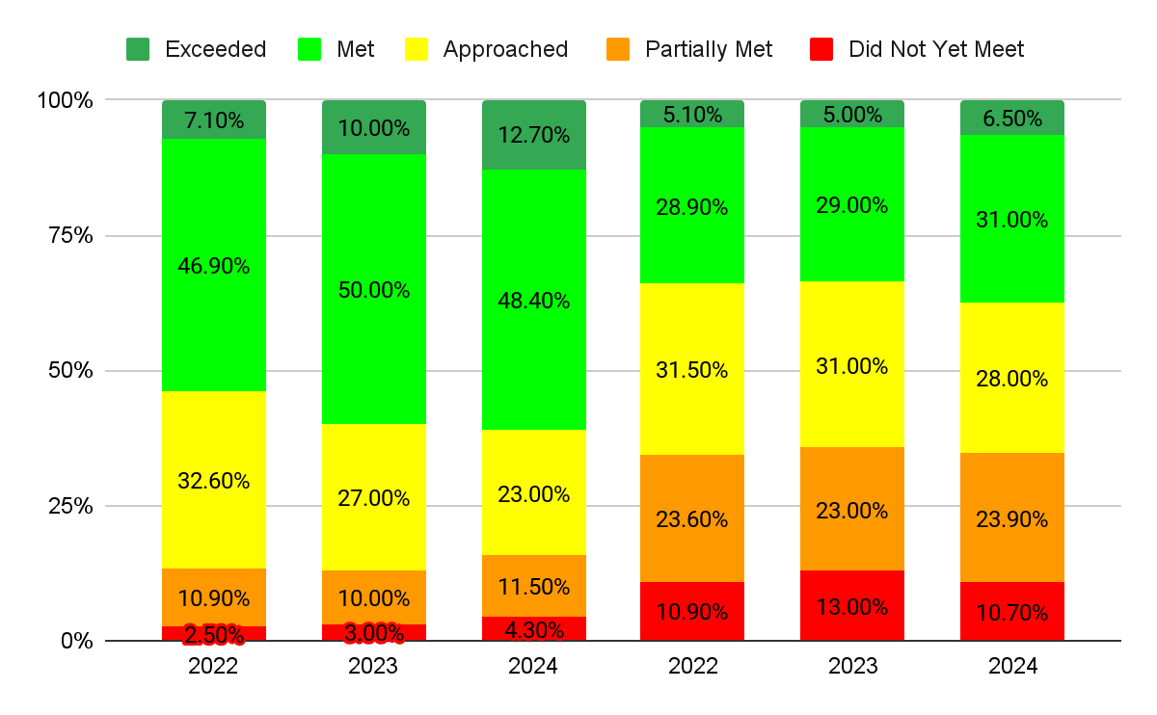
Math 7 (2022 to 2024)
SPF
NJ

Slide 50
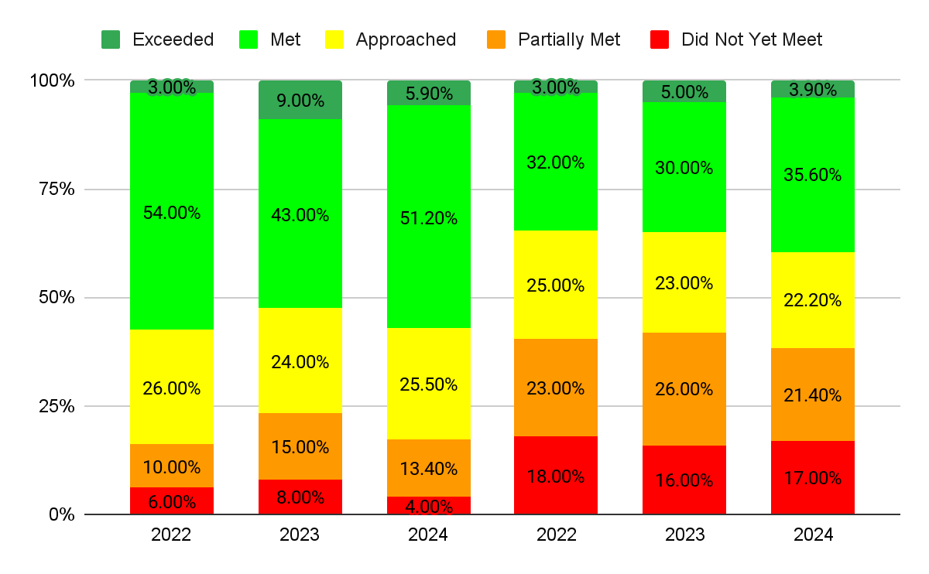
Algebra I (2022 to 2024)
SPF
NJ

Slide 51
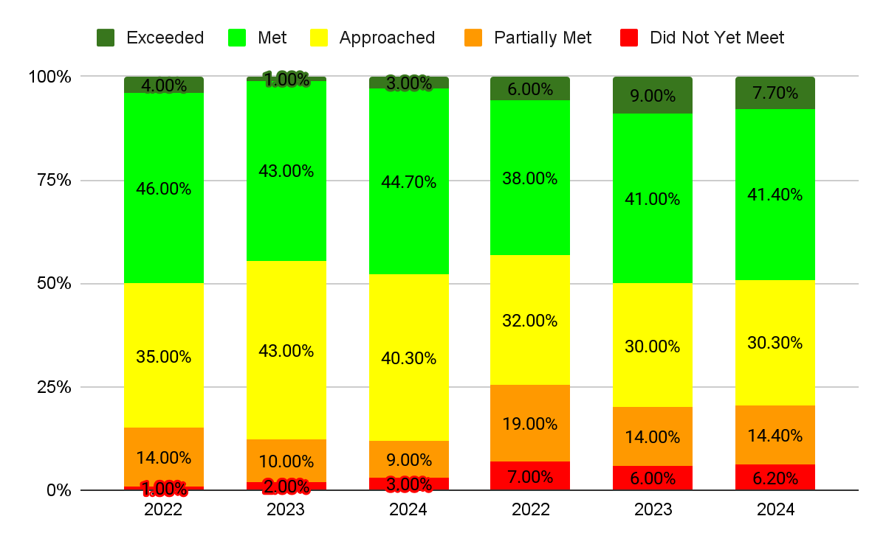
Geometry (2022 to 2024)
SPF
NJ

Slide 52
Setting our Data Lens….
COHORT GROWTH IN MATH
DIFFERENT GRADE LEVELS - SAME STUDENTS
DATA IS PRESENTED BY PERCENTAGE OF STUDENTS SCORING AT EACH LEVEL

Slide 53
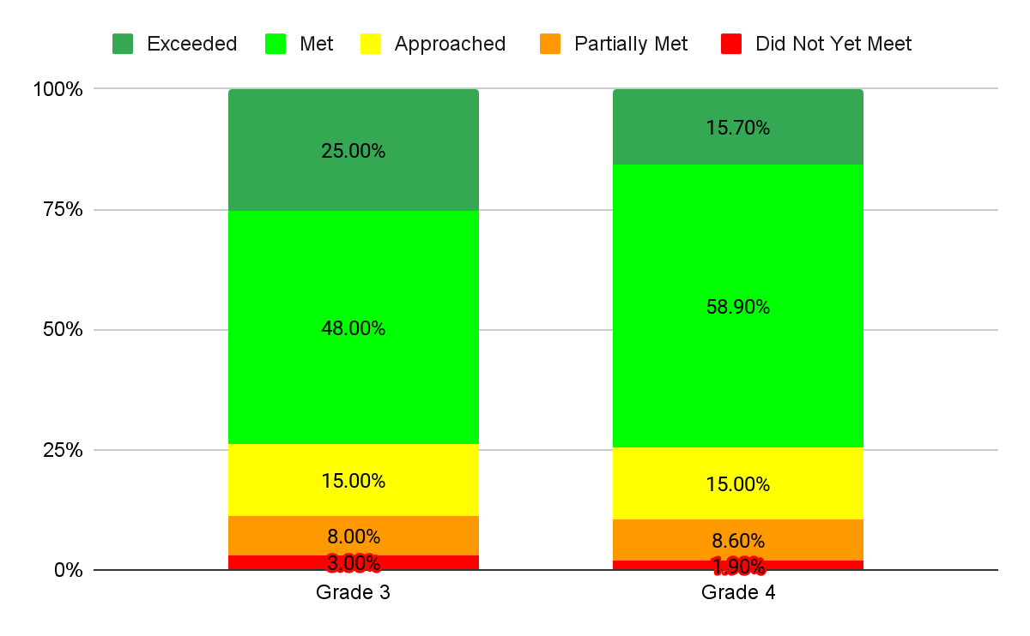
Current Grade 5 (Math Cohort Growth Grade 3 to Grade 4)

Slide 54
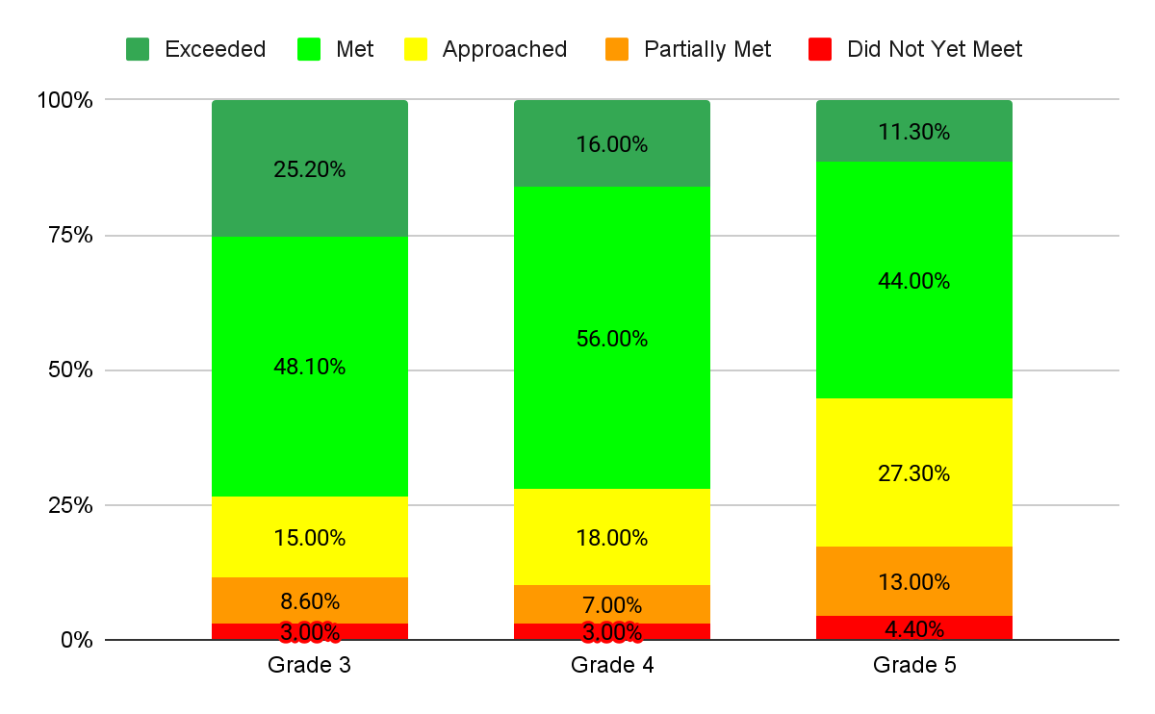
Current Grade 6 (Math Cohort Growth - Grade 3 to Grade 5)

Slide 55
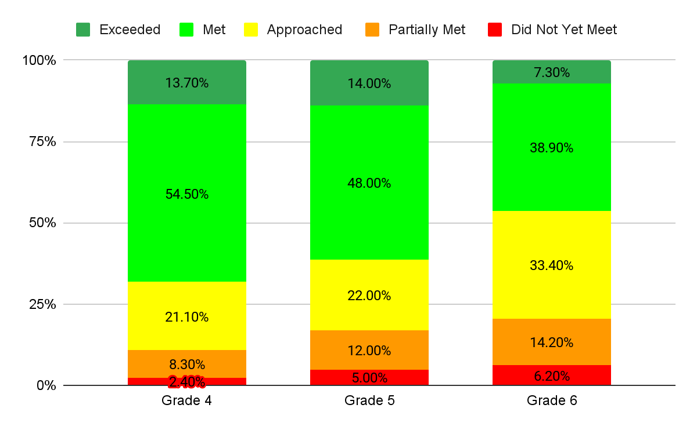
Current Grade 7 (Math Cohort Growth - Grade 4 to Grade 6)

Slide 56
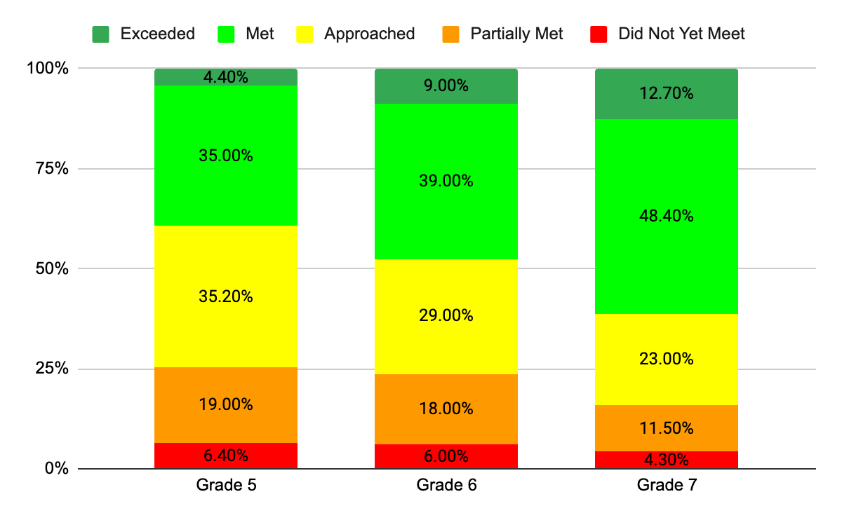
Current Grade 8 (Math Cohort Growth - Grade 3 to Grade 7)

Slide 57
Setting our Data Lens….
ACHIEVEMENT BY DEMOGRAPHIC GROUPS
Mathematics
DATA IS PRESENTED BY
PERCENTAGE OF STUDENTS MEETING/EXCEEDING EXPECTATIONS

Slide 58
Percentage of Students Meeting/Exceeding Expectations - Math
Gender | Total Tested | Percentage Meeting/Exceeding Expectations | +/- Change from 2023
Female | 1,481 | 56.6% | -1.13
Male | 1,466 | 60.26% | +.46

Slide 59
Percentage of Students Meeting/Exceeding Expectations - Math
Ethnicity/Race | Total Tested | Percentage Meeting/Exceeding Expectations | +/- Change from 2023
Hispanic or Latino | 461 | 43.83% | +1.23
Asian | 380 | 78.63% | -2.39
Black or African-American | 206 | 41.87% | -.11
White | 1,729 | 58.9% | -.93
Two or more races | 161 | 68.54% | -.53

Slide 60
Percentage of Students Meeting/Exceeding Expectations - Math
Program | Total Tested | Percentage Meeting/Exceeding Expectations | +/- Change from 2023
Students with Disabilities | 500 | 21.47% | -2.96
Economically Disadvantaged | 116 | 32.4% | +4.55
504 | 215 | 55.73% | +5.52
English Learners | 50 | 31.08% | +6.08

Slide 61
Summary Observations and Next Steps
Mathematics

Slide 62
Summary Observations: Mathematics
Above state average performance in most every grade level/Math course
Improved results across diverse demographic groups
Performance dips in transition years (3, 5, 6, Geometry)
Grades 5 and 6 still outperform 2022 cohort despite slight decrease from 2023

Slide 63
Next Steps: Mathematics
Enhance PD for small group differentiated instruction
Strengthen vertical articulation in transition grades (4-6, 8-9)
Bolster 5th grade platooning with content-specific support
Strategically implement MAP data findings
Integrate NJSLA-style questions into quarterly assessments
Diversify questioning techniques to boost critical thinking
Continue to maximize High Impact tutoring funds.

Slide 64
Science

Slide 65
NJSLA SCIENCE
Performance Levels
ADVANCED PROFICIENCY
PROFICIENT
NEAR PROFICIENCY
BELOW PROFICIENT
DATA IS PRESENTED BY PERCENTAGE OF STUDENTS SCORING AT EACH LEVEL

Slide 66
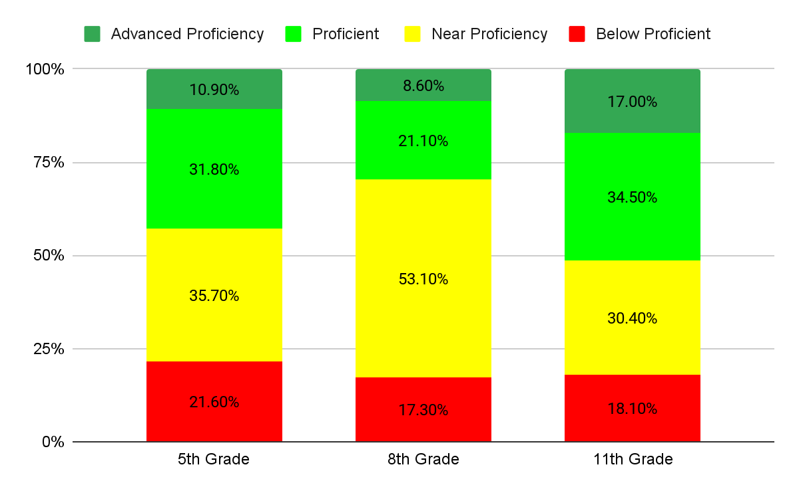
2024 SPF Science 5, 8 and 11 at a Glance

Slide 67
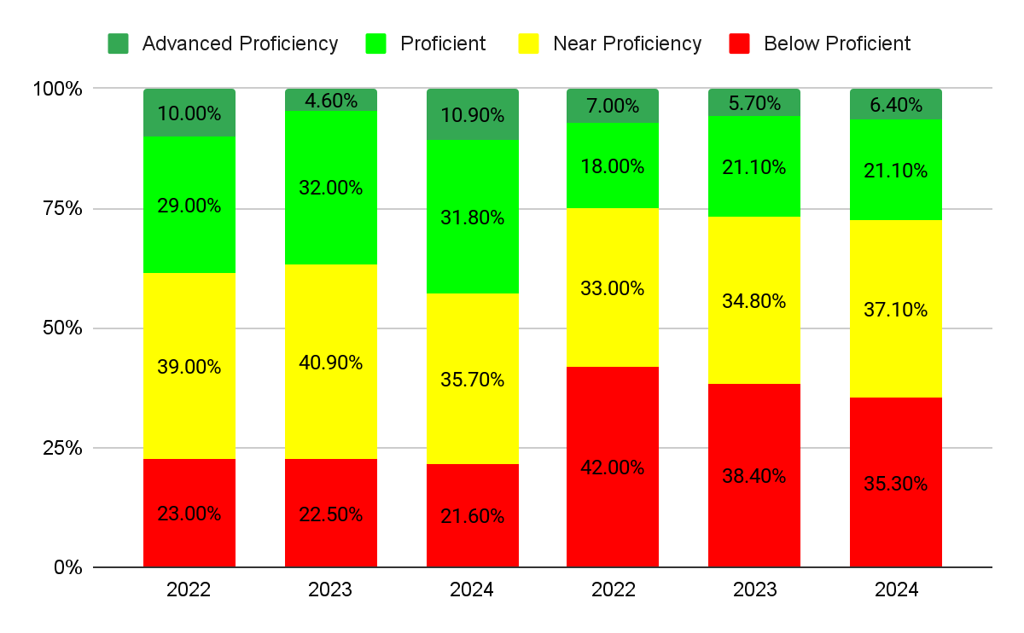
Science 5 (2022 to 2024)
SPF
NJ

Slide 68
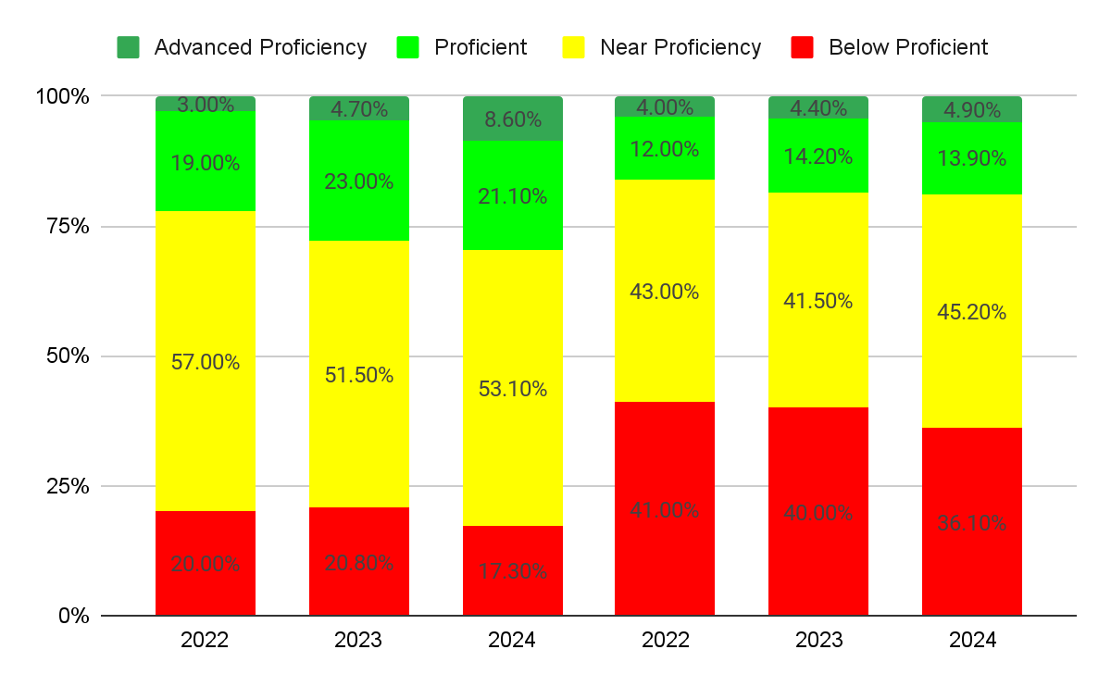
Science 8 (2022 to 2024)
SPF
NJ

Slide 69
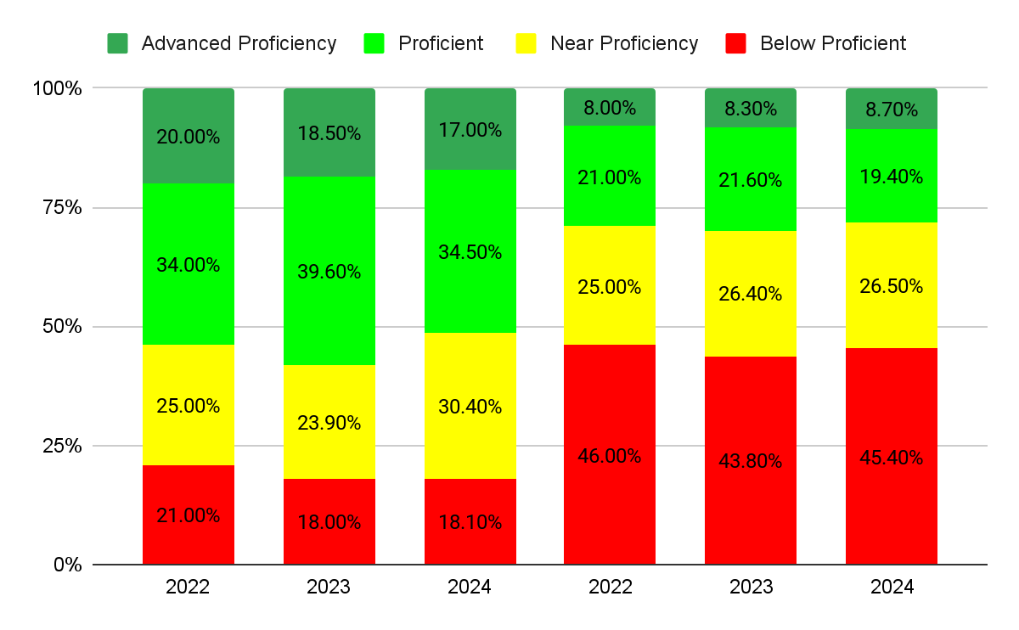
Science 11 (2022 to 2024)
SPF
NJ

Slide 70
Setting our Data Lens….
ACHIEVEMENT BY DEMOGRAPHIC GROUPS
SCIENCE
DATA IS PRESENTED BY
PERCENTAGE OF STUDENTS PROFICIENT/ADVANCED PROFICIENT

Slide 71
Percentage of Students Proficient/Advanced Proficient - Science
Gender | Total Tested | Percentage Meeting/Exceeding Expectations | +/- Change from 2023
Female | 650 | 40.3% | +1.6
Male | 638 | 42.07% | +1.6

Slide 72
Percentage of Students Proficient/Advanced Proficient - Science
Ethnicity/Race | Total Tested | Percentage Meeting/Exceeding Expectations | +/- Change from 2023
Hispanic or Latino | 201 | 30.13% | +.56
Asian | 135 | 57.57% | +4.64
Black or African-American | 102 | 25.67% | +3.5
White | 775 | 41.57% | -1.83
Two or more races | 71 | 63.23% | +13.1

Slide 73
Percentage of Students Proficient/Advanced Proficient - Science
Program | Total Tested | Percentage Meeting/Exceeding Expectations | +/- Change from 2023
Students with Disabilities | 231 | 15.73% | +4.5
Economically Disadvantaged | 62 | 18.6% | +3.3
504 | 201 | 40.47% | +6.27
Multilingual Learners | 18 | 11.1% | +11.1%
Former Multilingual Learners | 14 | 21.4% | +21.4%

Slide 74
Summary Observations and Next Steps
Science

Slide 75
Summary Observations: Science
Outperforming state average in all tested grades
Improved proficiency and advanced proficiency in 5th and 8th grades; fewer below proficient
Slight decrease in 11th grade proficiency, but still well above state average
Positive gains across diverse demographic groups, reflecting inclusive instructional efforts

Slide 76
Next Steps: Science
5th grade teaming shows positive impact, especially in physical science and critiquing practices; continue deepening curriculum focus
Middle school: Maintain integration of NJSLA-Science-style questions across all grades
High school: Balance content demands with science/engineering practices; emphasize investigation, sensemaking, and critiquing to boost literacy and proficiency

Slide 77
Student Reflections - we asked 5th graders

Slide 78
Student Reflections - we asked 5th graders
What do state test results not tell us about you as a student?

Slide 79
What do state test results not tell us about you as a student?
What I’m good at.

Slide 80
What do state test results not tell us about you as a student?
They can’t tell that I was very scared and nervous to take the test, they also couldn't see that I like different things
What I’m good at.

Slide 81
What do state test results not tell us about you as a student?
They can’t tell that i was very scared and nervous to take the test, they also couldn't see that I like different things
What I’m good at.
State test results don’t tell about what we felt while taking this test.

Slide 82
What do state test results not tell us about you as a student?
They can’t tell that i was very scared and nervous to take the test, they also couldn't see that I like different things
They don’t tell that we are smart and we know how to learn .
What I’m good at.
State test results don’t tell about what we felt while taking this test.

Slide 83
What do state test results not tell us about you as a student?
They can’t tell that i was very scared and nervous to take the test, they also couldn't see that I like different things
They don’t tell that we are smart and we know how to learn .
What I’m good at.
I work hard
State test results don’t tell about what we felt while taking this test.

Slide 84
What do state test results not tell us about you as a student?
They can’t tell that i was very scared and nervous to take the test, they also couldn't see that I like different things
They don’t tell that we are smart and we know how to learn .
What I’m good at.
I work hard
Who I really am and who I want to be
State test results don’t tell about what we felt while taking this test.

Slide 85
What do state test results not tell us about you as a student?
They can’t tell that i was very scared and nervous to take the test, they also couldn't see that I like different things
They don’t tell that we are smart and we know how to learn .
What I’m good at.
I work hard
Who I really am and who I want to be
What state test results do not tell you in a student is what is happening at home or school to cause distraction or discomfort.
State test results don’t tell about what we felt while taking this test.

Slide 86
What do state test results not tell us about you as a student?
They can’t tell that i was very scared and nervous to take the test, they also couldn't see that I like different things
State test results don’t tell you about how I am a hard working student, a loving, kind, and grateful friend, am passionate about my sports, and I appreciate my friends and family
They don’t tell that we are smart and we know how to learn .
What I’m good at.
I work hard
Who I really am and who I want to be
What state test results do not tell you in a student is what is happening at home or school to cause distraction or discomfort.
State test results don’t tell about what we felt while taking this test.

Slide 87
Thank you.
Visit the district website to view the presentation and to learn more…

Slide 88
Thank you.
Behind every data point there is a child.
Visit the district website to view the presentation and to learn more…

